Slide 1
GAUSSIAN NOISE
Nada Jankovic 468-12

Slide 2
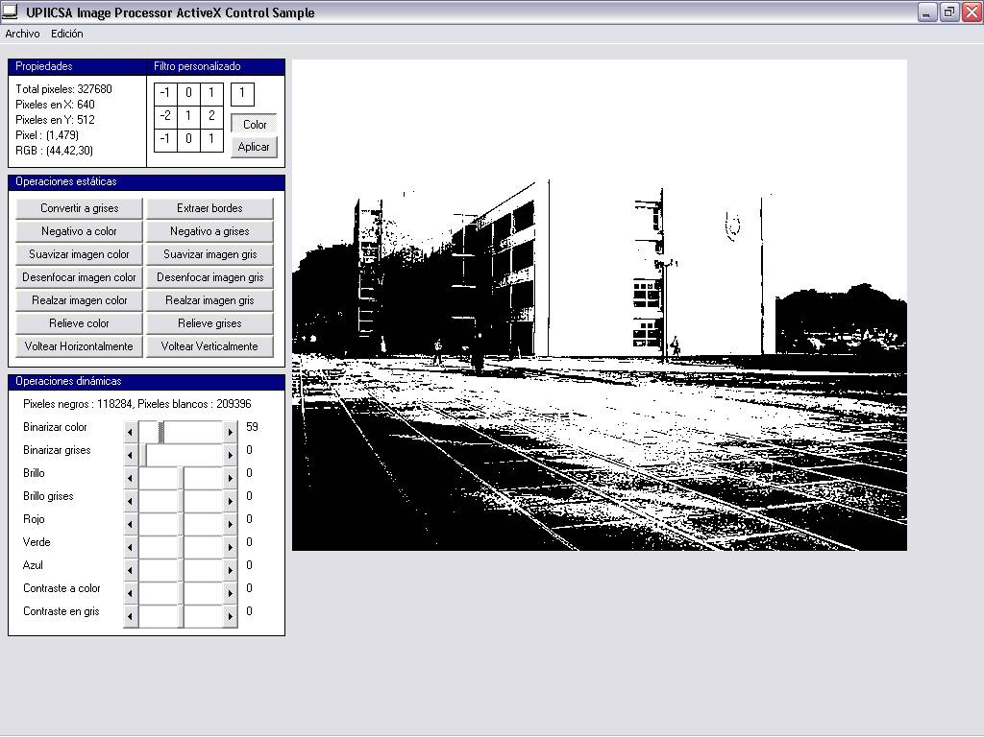
Mathematics
Image editing
Filtering
2 | 4

Slide 3

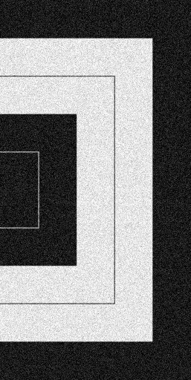
Arts
Photo retouching
Filtering
Layers

Slide 4
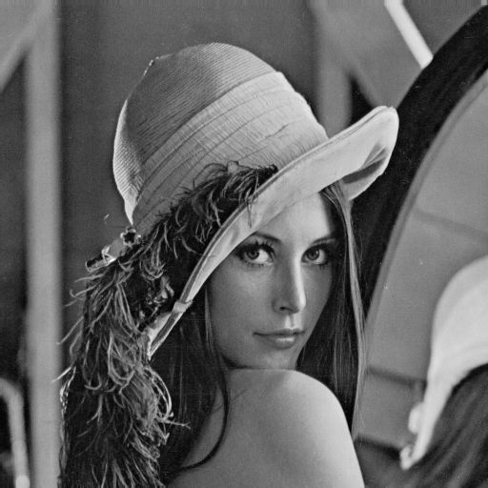
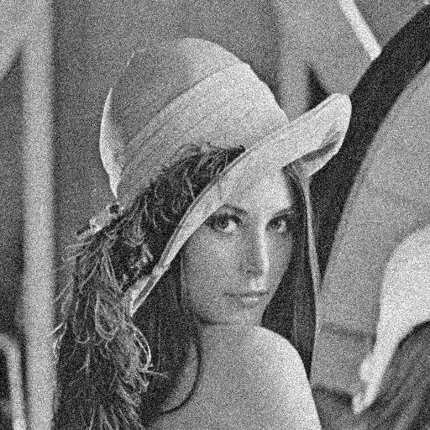
Digital Image Processing

